Slide 1

Spatial Data Mining

Slide 2
Outline
Motivation, Spatial Pattern Families
Spatial data types and relationships
Limitations of Traditional Statistics
Location Prediction model
Hotspots
Spatial outliers
Colocations and Co-occurrences
Summary: What is special about mining spatial data?

Slide 3
Learning Objectives
After this segment, students will be able to
Describe the motivation for spatial data mining
List common pattern families

Slide 4
Why Data Mining?
Holy Grail - Informed Decision Making
Sensors & Databases increased rate of Data Collection
Transactions, Web logs, GPS-track, Remote sensing, …
Challenges:
Volume (data) >> number of human analysts
Some automation needed
Approaches
Database Querying, e.g., SQL3/OGIS
Data Mining for Patterns
…

Slide 5
Data Mining vs. Database Querying
Recall Database Querying (e.g., SQL3/OGIS)
Can not answer questions about items not in the database!
Ex. Predict tomorrow’s weather or credit-worthiness of a new customer
Can not efficiently answer complex questions beyond joins
Ex. What are natural groups of customers?
Ex. Which subsets of items are bought together?
Data Mining may help with above questions!
Prediction Models
Clustering, Associations, …

Slide 6
Spatial Data Mining (SDM)
The process of discovering
interesting, useful, non-trivial patterns
patterns: non-specialist
exception to patterns: specialist
from large spatial datasets
Spatial pattern families
Hotspots, Spatial clusters
Spatial outlier, discontinuities
Co-locations, co-occurrences
Location prediction models
…

Slide 7
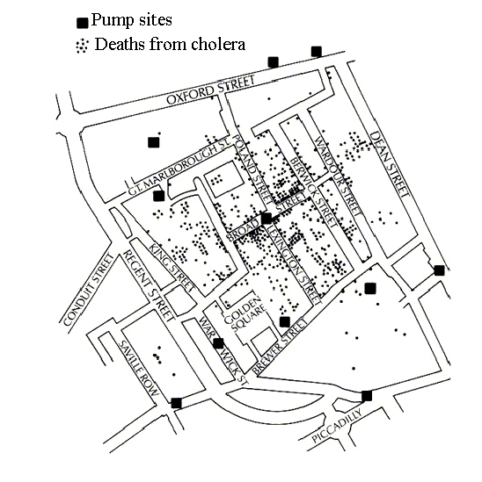

Pattern Family 1: Hotspots, Spatial Cluster
The 1854 Asiatic Cholera in London
Near Broad St. water pump except a brewery

Slide 8
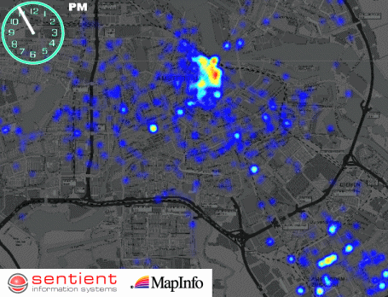
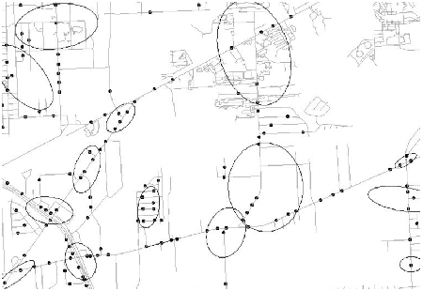
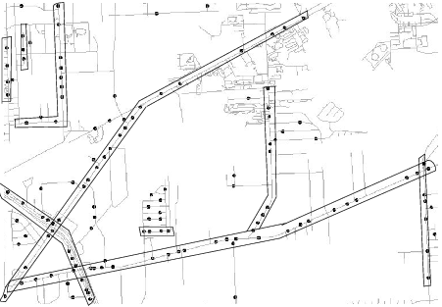
Complicated Hotspots
Complication Dimensions
Time
Spatial Networks
Challenges: Trade-off b/w
Semantic richness and
Scalable algorithms

Slide 9
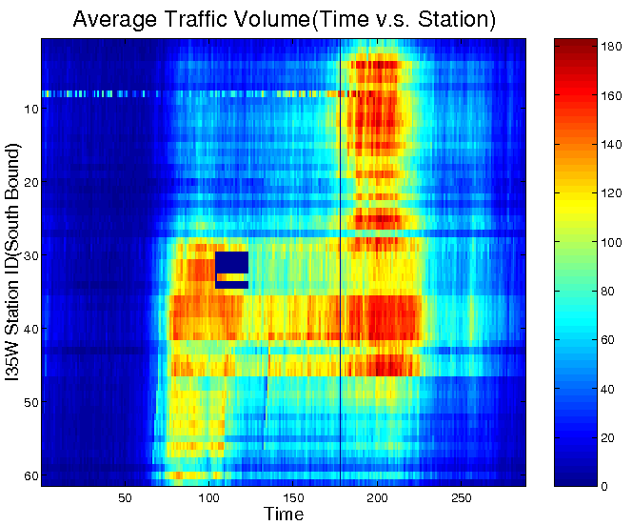
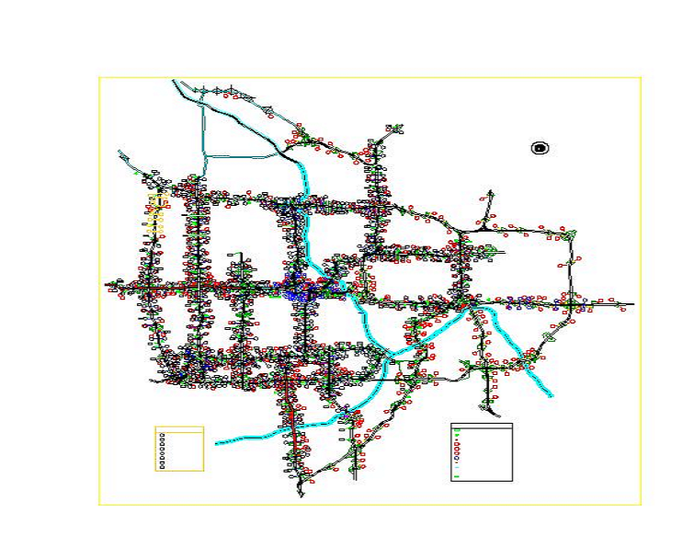
Pattern Family 2: Spatial Outliers
Spatial Outliers, Anomalies, Discontinuities
Traffic Data in Twin Cities
Abnormal Sensor Detections
Spatial and Temporal Outliers
Source: A Unified Approach to Detecting Spatial Outliers, GeoInformatica, 7(2), Springer, June 2003.
(A Summary in Proc. ACM SIGKDD 2001) with C.-T. Lu, P. Zhang.

Slide 10
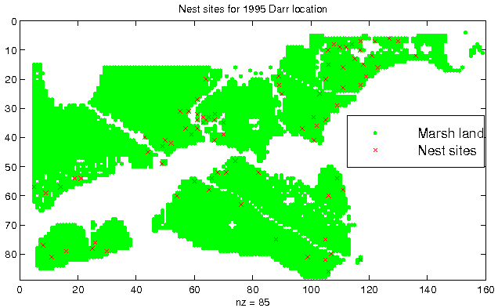
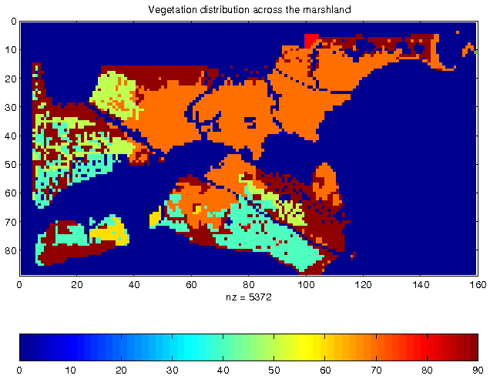
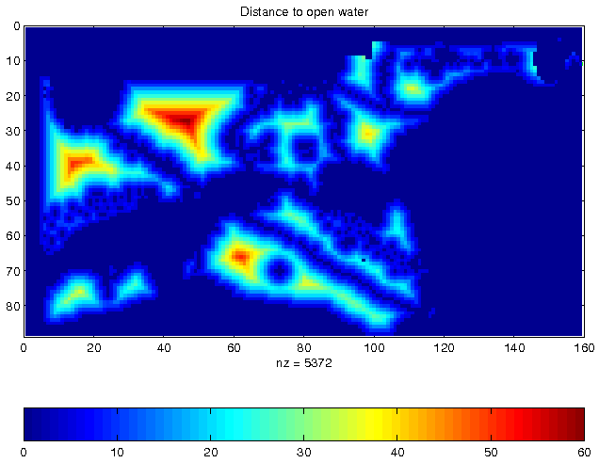
Pattern Family 3: Predictive Models
Location Prediction:
Predict Bird Habitat Prediction
Using environmental variables

Slide 11
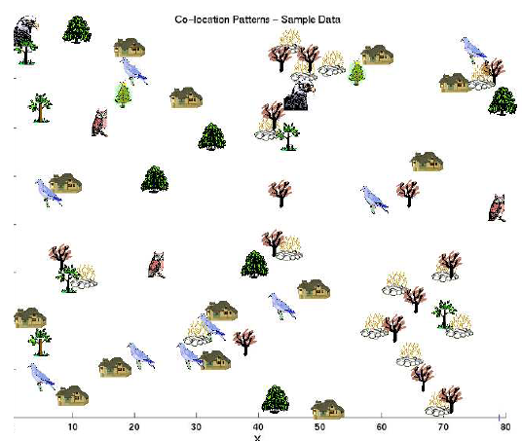
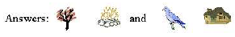
Family 4: Co-locations/Co-occurrence
Given: A collection of different types of spatial events
Find: Co-located subsets of event types
Source: Discovering Spatial Co-location Patterns: A General Approach, IEEE Transactions
on Knowledge and Data Eng., 16(12), December 2004 (w/ H.Yan, H.Xiong).

Slide 12
What’s NOT Spatial Data Mining (SDM)
Simple Querying of Spatial Data
Find neighbors of Canada, or shortest path from Boston to Houston
Testing a hypothesis via a primary data analysis
Ex. Is cancer rate inside Hinkley, CA higher than outside ?
SDM: Which places have significantly higher cancer rates?
Uninteresting, obvious or well-known patterns
Ex. (Warmer winter in St. Paul, MN) => (warmer winter in Minneapolis, MN)
SDM: (Pacific warming, e.g. El Nino) => (warmer winter in Minneapolis, MN)
Non-spatial data or pattern
Ex. Diaper and beer sales are correlated
SDM: Diaper and beer sales are correlated in blue-collar areas (weekday evening)

Slide 13
Quiz
Categorize following into queries, hotspots, spatial outlier, colocation, location prediction:
(a) Which countries are very different from their neighbors?
(b) Which highway-stretches have abnormally high accident rates ?
(c) Forecast landfall location for a Hurricane brewing over an ocean?
(d) Which retail-store-types often co-locate in shopping malls?
(e) What is the distance between Beijing and Chicago?

Slide 14
Outline
Motivation, Spatial Pattern Families
Spatial data types and relationships
Limitations of Traditional Statistics
Location Prediction model
Hotspots
Spatial outliers
Colocations and Co-occurrences
Summary: What is special about mining spatial data?

Slide 15
Learning Objectives
After this segment, students will be able to
Describe the input of spatial data mining
List 3 common spatial data-types and operations
Use spatial operations for Feature Selection

Slide 16
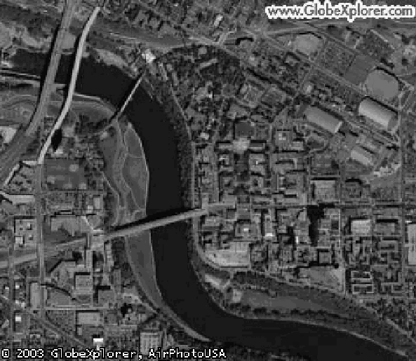
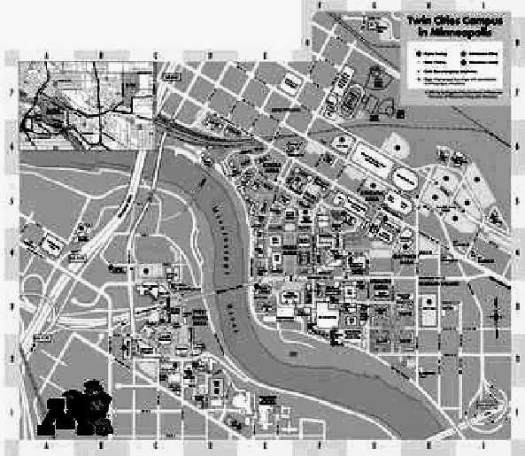
Data-Types: Non-Spatial vs. Spatial
Non-spatial
Numbers, text-string, …
e.g., city name, population
Spatial (Geographically referenced)
Location, e.g., longitude, latitude, elevation
Neighborhood and extent
Spatial Data-types
Raster: gridded space
Vector: point, line, polygon, …
Graph: node, edge, path
Raster (Courtesy: UMN)
Vector (Courtesy: MapQuest)

Slide 17
Relationships: Non-spatial vs. Spatial
Non-spatial Relationships
Explicitly stored in a database
Ex. New Delhi is the capital of India
Spatial Relationships
Implicit, computed on demand
Topological: meet, within, overlap, …
Directional: North, NE, left, above, behind, …
Metric: distance, area, perimeter
Focal: slope
Zonal: highest point in a country
…

Slide 18
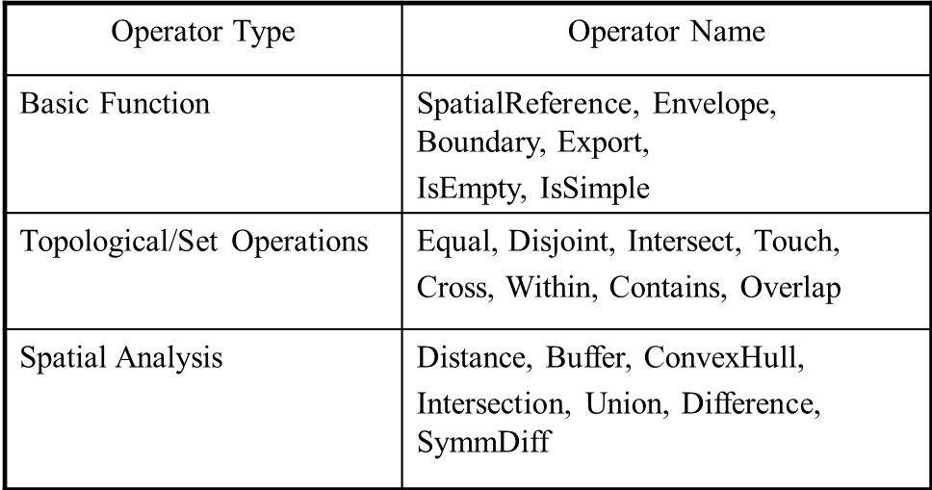
OGC Simple Features
Open GIS Consortium: Simple Feature Types
Vector data types: e.g. point, line, polygons
Spatial operations :
Examples of Operations in OGC Model

Slide 19
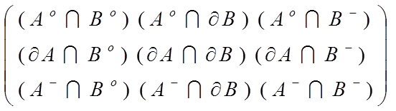
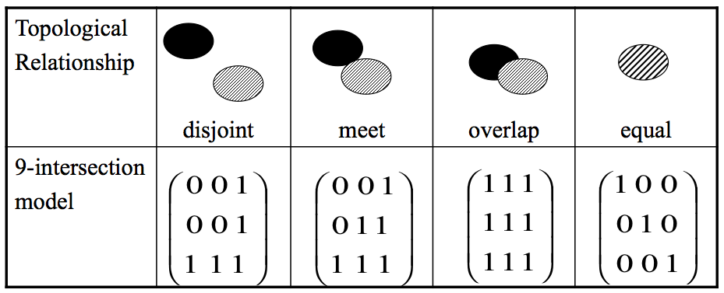
OGIS – Topological Operations
Interior(B)
Boundary(B)
Exterior(B)
Topology: 9-intersections
interior
boundary
exterior
Interior(A)
Boundary(A)
Exterior(A)

Slide 20
Research Needs for Data
Limitations of OGC Model
Direction predicates - e.g. absolute, ego-centric
3D and visibility, Network analysis, Raster operations
Spatio-temporal
Needs for New Standards & Research
Modeling richer spatial properties listed above
Spatio-temporal data, e.g., moving objects

Slide 21
Quiz
Which of the following is not describing a spatial relationship?
a) Seoul is the capital of South Korea
b) Slovakia and Hungary are neighboring countries
c) Nile river crosses Sudan
d) Venezuela is north of Argentina

Slide 22
Outline
Motivation, Spatial Pattern Families
Spatial data types and relationships
Limitations of Traditional Statistics
Location Prediction model
Hotspots
Spatial outliers
Colocations and Co-occurrences
Summary: What is special about mining spatial data?

Slide 23
Learning Objectives
After this segment, students will be able to
List limitations of traditional statistics for spatial data
Describe simple concepts in spatial statistics
Spatial auto-correlation
Spatial heterogeneity
Describe first law of Geography

Slide 24
Limitations of Traditional Statistics
Classical Statistics
Data samples: independent and identically distributed (i.i.d)
Simplifies mathematics underlying statistical methods, e.g., Linear Regression
Spatial data samples are not independent
Spatial Autocorrelation metrics
distance-based (e.g., K-function), neighbor-based (e.g., Moran’s I)
Spatial Cross-Correlation metrics
Spatial Heterogeneity
Spatial data samples may not be identically distributed!
No two places on Earth are exactly alike!
…

Slide 25
Spatial Statistics: An Overview
Point process
Discrete points, e.g., locations of trees, accidents, crimes, …
Complete spatial randomness (CSR): Poisson process in space
K-function: test of CSR
Geostatistics
Continuous phenomena, e.g., rainfall, snow depth, …
Methods: Variogram measure how similarity decreases with distance
Spatial interpolation, e.g., Kriging
Lattice-based statistics
Polygonal aggregate data, e.g., census, disease rates, pixels in a raster
Spatial Gaussian models, Markov Random Fields, Spatial Autoregressive Model

Slide 26
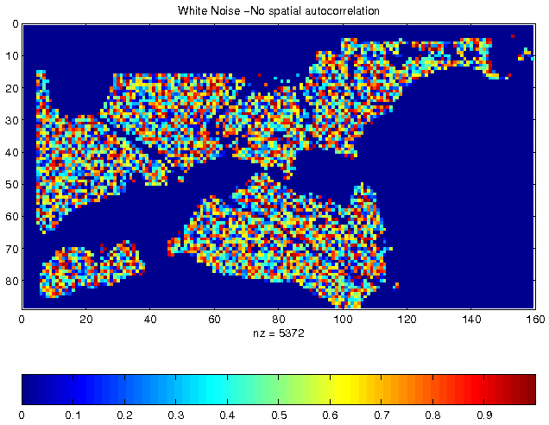
Spatial Autocorrelation (SA)
First Law of Geography
All things are related, but nearby things are more related than distant things. [Tobler70]
Spatial autocorrelation
Traditional i.i.d. assumption is not valid
Measures: K-function, Moran’s I, Variogram, …
Independent, Identically Distributed pixel property
Vegetation Durability with SA

Slide 27
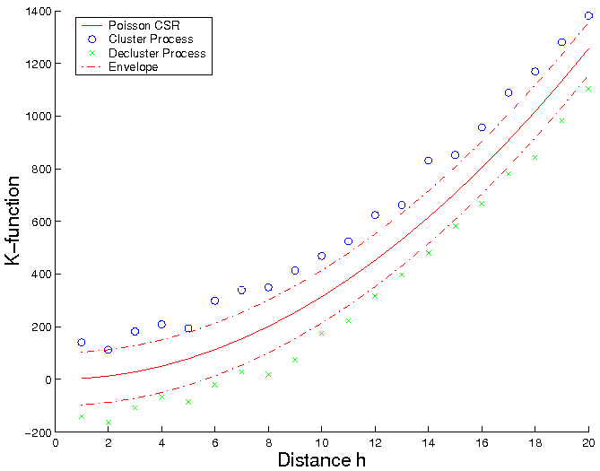
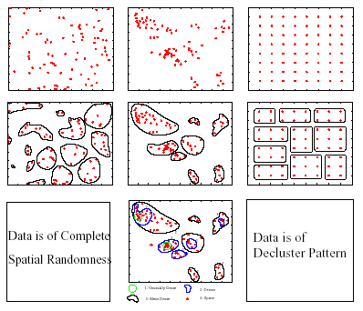
Spatial Autocorrelation: K-Function
Purpose: Compare a point dataset with a complete spatial random (CSR) data
Input: A set of points
where λ is intensity of event
Interpretation: Compare k(h, data) with K(h, CSR)
K(h, data) = k(h, CSR): Points are CSR
> means Points are clustered
< means Points are de-clustered
[number of events within distance h of an arbitrary event]
CSR
Clustered
De-clustered

Slide 28
Cross-Correlation
Cross K-Function Definition
Cross K-function of some pair of spatial feature types
Example
Which pairs are frequently co-located
Statistical significance
[number of type j event within distance h
of a randomly chosen type i event]

Slide 29
Recall Pattern Family 4: Co-locations
Given: A collection of different types of spatial events
Find: Co-located subsets of event types
Source: Discovering Spatial Co-location Patterns: A General Approach, IEEE Transactions
on Knowledge and Data Eng., 16(12), December 2004 (w/ H.Yan, H.Xiong).

Slide 30
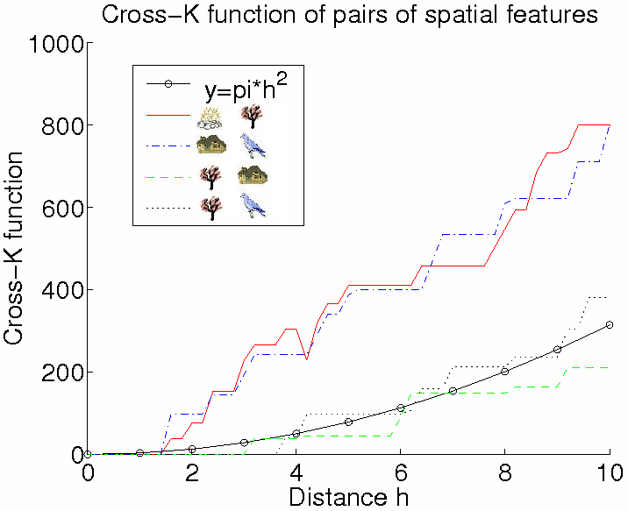
Illustration of Cross-Correlation
Illustration of Cross K-function for Example Data
Cross-K Function for Example Data

Slide 31
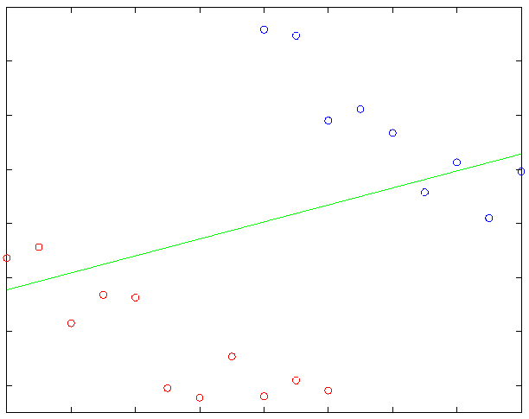
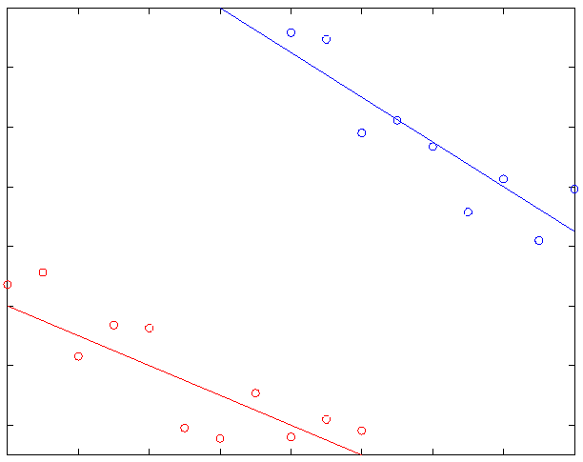
Spatial Heterogeneity
“Second law of geography” [M. Goodchild, UCGIS 2003]
Global model might be inconsistent with regional models
Spatial Simpson’s Paradox
May improve the effectiveness of SDM, show support regions of a pattern

Slide 32
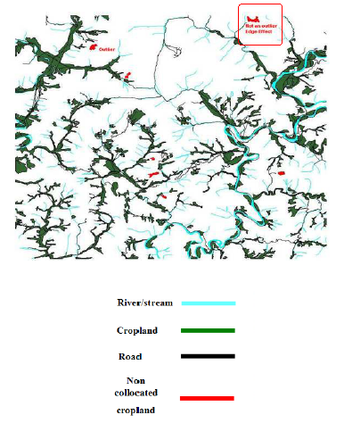
Edge Effect
Cropland on edges may not be classified as outliers
No concept of spatial edges in classical data mining
Korea Dataset, Courtesy: Architecture Technology Corporation

Slide 33
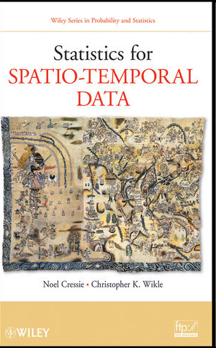
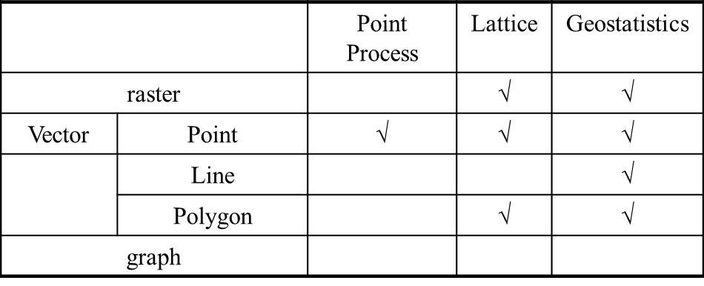

Research Challenges of Spatial Statistics
State-of-the-art of Spatial Statistics
Data Types and Statistical Models
Research Needs
Correlating extended features, road, rivers, cropland
Spatio-temporal statistics
Spatial graphs, e.g., reports with street address

Slide 34
Quiz
Which of the following is not attributed to spatial auto-correlation?
a) Nearby cities have similar climate
b) Neighboring areas tend to plant similar farm crops
c) Near things are more related than distant things
d) Spatial data mining results are less reliable near
the edges of a study area

Slide 35
Outline
Motivation, Spatial Pattern Families
Spatial data types and relationships
Limitations of Traditional Statistics
Location Prediction model
Hotspots
Spatial outliers
Colocations and Co-occurrences
Summary: What is special about mining spatial data?

Slide 36
Learning Objectives
After this segment, students will be able to
Compare traditional & location prediction models
Contrast Linear Regression & Spatial Auto-Regression

Slide 37
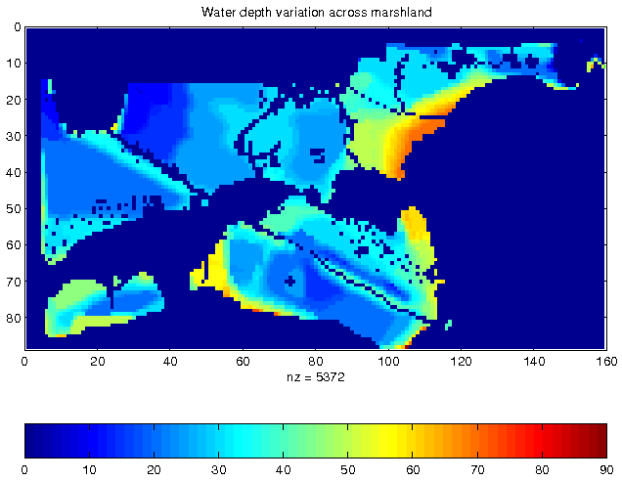
Illustration of Location Prediction Problem
Nest Locations
Vegetation Index
Water Depth
Distance to Open Water

Slide 38
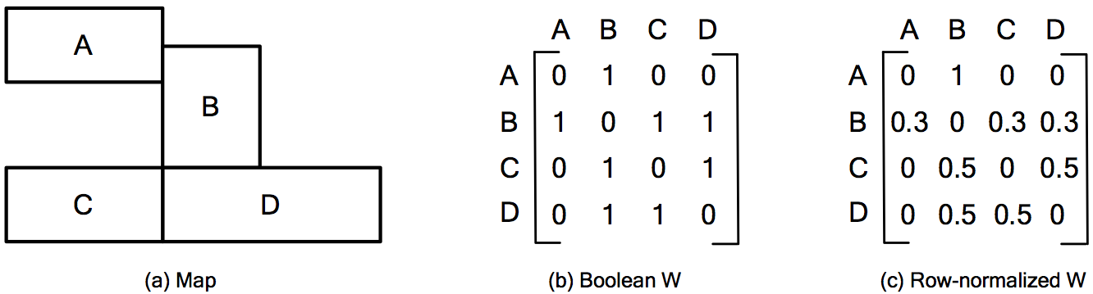
Neighbor Relationship: W Matrix

Slide 39
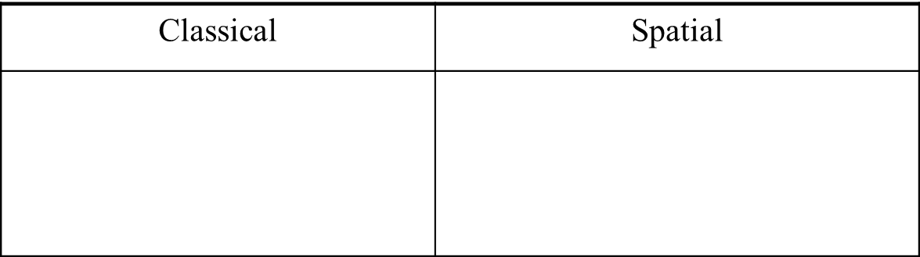
Location Prediction Models
Traditional Models, e.g., Regression (with Logit or Probit),
Bayes Classifier, …
Spatial Models
Spatial autoregressive model (SAR)
Markov random field (MRF) based Bayesian Classifier

Slide 40
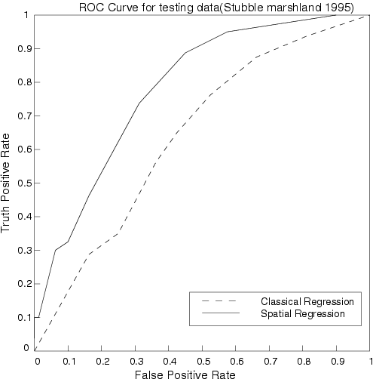
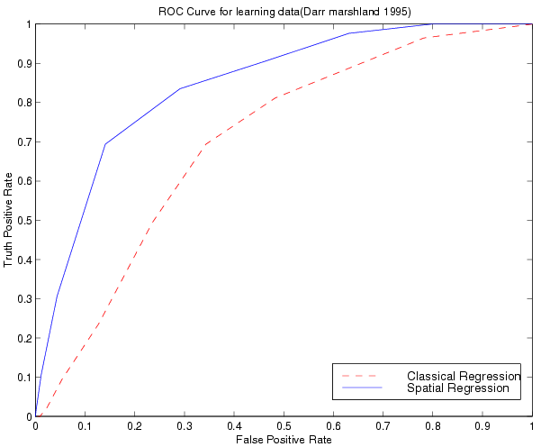
Comparing Traditional and Spatial Models
Dataset: Bird Nest prediction
Linear Regression
Lower prediction accuracy, coefficient of determination,
Residual error with spatial auto-correlation
Spatial Auto-regression outperformed linear regression
ROC Curve
for learning
ROC Curve
for testing

Slide 41
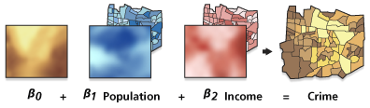
Modeling Spatial Heterogeneity: GWR
Geographically Weighted Regression (GWR)
Goal: Model spatially varying relationships
Example:
Where are location dependent
Source: resources.arcgis.com

Slide 42
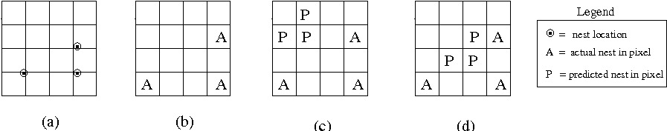
Research Needs for Location Prediction
Spatial Auto-Regression
Estimate W
Scaling issue
Spatial interest measure
e.g., distance(actual, predicted)
Actual Sites
Pixels with
actual sites
Prediction 1
Prediction 2.
Spatially more interesting
than Prediction 1

Slide 43
Quiz
Which of the following is true about spatial autoregressive model (SAR)?
a) It has lower computational cost than traditional regression model
b) It takes neighborhood information into account
c) It is less general than traditional regression model
d) None of the above

Slide 44
Outline
Motivation, Spatial Pattern Families
Spatial data types and relationships
Limitations of Traditional Statistics
Location Prediction model
Hotspots
Spatial outliers
Colocations and Co-occurrences
Summary: What is special about mining spatial data?

Slide 45
Learning Objectives
After this segment, students will be able to
Compare traditional & spatial clustering methods
Contrast K-Means and SatScan

Slide 46
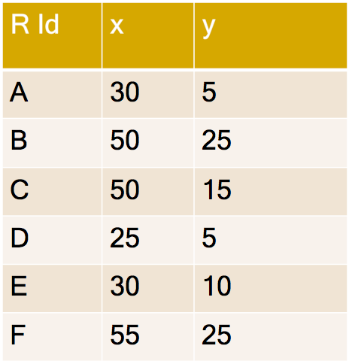
Clustering Question
Question: What are natural groups of points?

Slide 47
Maps Reveal Spatial Groups
Map shows 2 spatial groups!
B
F
20
C
y
10
E
D
A
30
40
50
x

Slide 48
K-Means Algorithm
1. Start with random seeds
K = 2
B
F
20
Seed
C
Seed
y
10
E
D
A
30
40
50
x

Slide 49
K-Means Algorithm
B
F
2. Assign points to closest seed
20
K = 2
Seed
C
y
10
E
Seed
D
A
30
40
50
x
B
F
20
C
y
10
E
D
A
30
40
50
x

Slide 50
K-Means Algorithm
3. Revise seeds to group centers
K = 2
Revised seeds
B
F
20
C
y
10
E
D
A
30
40
50
x

Slide 51
K-Means Algorithm
B
F
2. Assign points to closest seed
20
K = 2
C
Colors show
closest Seed
y
10
E
D
A
30
40
50
x
Revised seeds
B
F
20
C
y
10
E
D
A
30
40
50
x

Slide 52
K-Means Algorithm
B
3. Revise seeds to group centers
F
20
K = 2
C
y
10
E
Colors show
closest Seed
D
A
30
40
50
x
B
F
20
Revised seeds
C
y
10
E
D
A
30
40
50
x

Slide 53
K-Means Algorithm
If seeds changed then loop back to
Step 2. Assign points to closest seed
K = 2
B
F
20
Colors show
closest Seed
C
y
10
E
D
A
30
40
50
x

Slide 54
K-Means Algorithm
B
F
3. Revise seeds to group centers
20
K = 2
C
Termination
y
10
E
D
A
30
40
50
x
B
F
20
Colors show
closest Seed
C
y
10
E
D
A
30
40
50
x

Slide 55
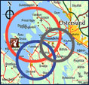
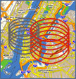

Limitations of K-Means
K-Means does not test Statistical Significance
Finds chance clusters in complete spatial randomness (CSR)
Classical
Clustering
Spatial
Clustering

Slide 56
Spatial Scan Statistics (SatScan)
Goal: Omit chance clusters
Ideas: Likelihood Ratio, Statistical Significance
Steps
Enumerate candidate zones & choose zone X with highest likelihood ratio (LR)
LR(X) = p(H1|data) / p(H0|data)
H0: points in zone X show complete spatial randomness (CSR)
H1: points in zone X are clustered
If LR(Z) >> 1 then test statistical significance
Check how often is LR( CSR ) > LR(Z)
using 1000 Monte Carlo simulations

Slide 57
SatScan Examples
Test 1: Complete Spatial Randomness
SatScan Output: No hotspots !
Highest LR circle is a chance cluster!
p-value = 0.128
Test 2: Data with a hotspot
SatScan Output: One significant hotspot!
p-value = 0.001

Slide 58
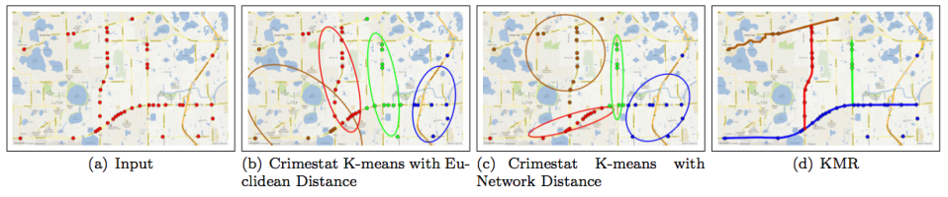
Spatial-Concept/Theory-Aware Clusters
Spatial Theories, e.g,, environmental criminology
Circles ➔ Doughnut holes
Geographic features, e.g., rivers, streams, roads, …
Hot-spots => Hot Geographic-features
Source: A K-Main Routes Approach to Spatial Network Activity Summarization, to appear in IEEE
Transactions on Knowledge and Data Eng. (www.computer.org/csdl/trans/tk/preprint/06574853-abs.html)

Slide 59
Quiz
Which of the following is false?
a) SatScan computes likelihood ratio and tests statistical
significance to eliminate many chance clusters
b) Monte Carlo simulation may help estimate statistical
significance
c) K-means is able to omit chance clusters
d) K-means finds clusters even in data representing complete
spatial randomness

Slide 60
Outline
Motivation, Spatial Pattern Families
Spatial data types and relationships
Limitations of Traditional Statistics
Location Prediction model
Hotspots
Spatial outliers
Colocations and Co-occurrences
Summary: What is special about mining spatial data?

Slide 61
Learning Objectives
After this segment, students will be able to
Contrast global & spatial outliers
List spatial outlier detection tests

Slide 62
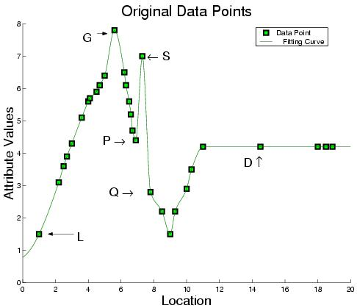
Outliers: Global (G) vs. Spatial (S)

Slide 63
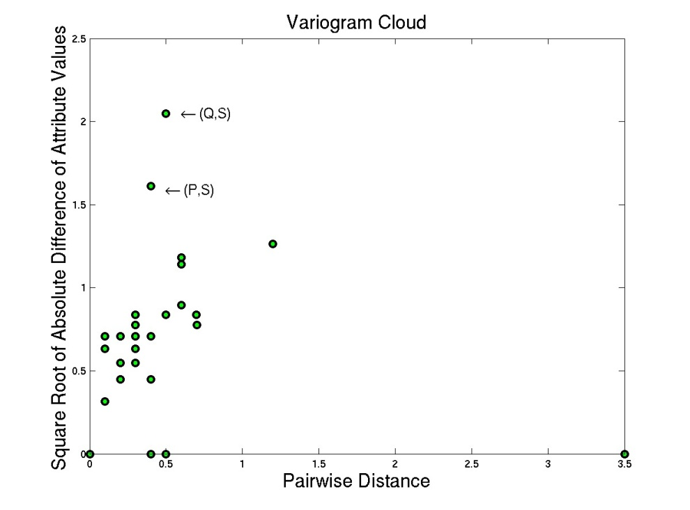
Outlier Detection Tests: Variogram Cloud
Graphical Test: Variogram Cloud

Slide 64
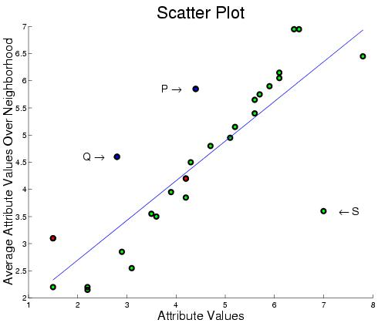
Outlier Detection – Scatterplot
Quantitative Tests: Scatter Plot

Slide 65
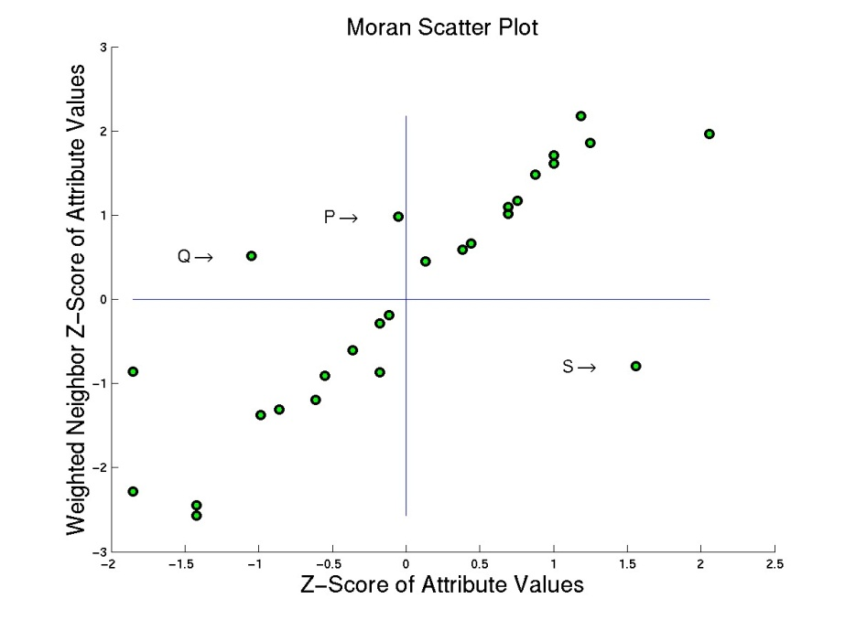
Outlier Detection Test: Moran Scatterplot
Graphical Test: Moran Scatter Plot

Slide 66
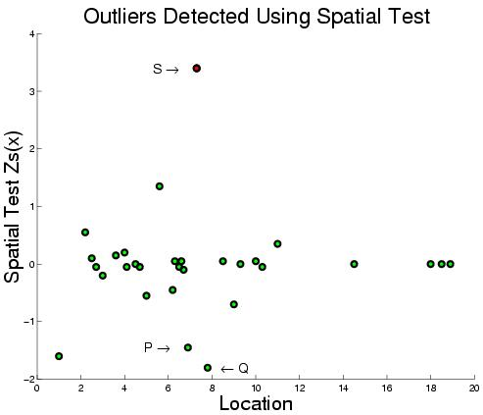
Outlier Detection Tests: Spatial Z-test
Quantitative Tests: Spatial Z-test
Algorithmic Structure: Spatial Join on neighbor relation

Slide 67
Spatial Outlier Detection: Computation
Separate two phases
Model Building
Testing: test a node (or a set of nodes)
Computation Structure of Model Building
Key insights:
Spatial self join using N(x) relationship
Algebraic aggregate function computed in one scan of spatial join

Slide 68
Trends in Spatial Outlier Detection
Multiple spatial outlier detection
Eliminating the influence of neighboring outliers
Multi-attribute spatial outlier detection
Use multiple attributes as features
Scale up for large data

Slide 69
Quiz
Which of the following is false about spatial outliers?
a) Oasis (isolated area of vegetation) is a spatial outlier area in a desert
b) They may detect discontinuities and abrupt changes
c) They are significantly different from their spatial neighbors
d) They are significantly different from entire population

Slide 70
Outline
Motivation, Spatial Pattern Families
Spatial data types and relationships
Limitations of Traditional Statistics
Location Prediction model
Hotspots
Spatial outliers
Colocations and Co-occurrences
Summary: What is special about mining spatial data?

Slide 71
Learning Objectives
After this segment, students will be able to
Contrast colocations and associations
Describe colocation interest measures

Slide 72
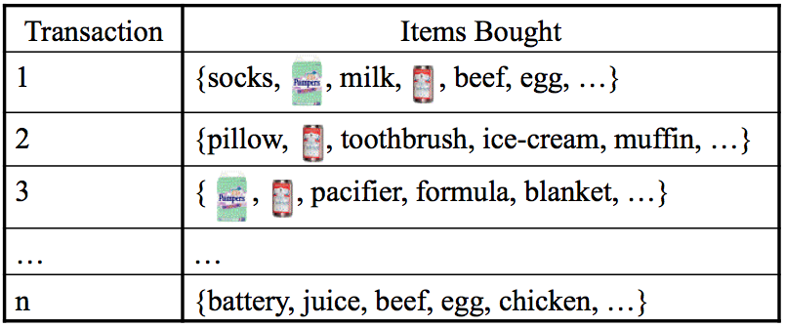
Background: Association Rules
Association rule e.g. (Diaper in T => Beer in T)
Support: probability (Diaper and Beer in T) = 2/5
Confidence: probability (Beer in T | Diaper in T) = 2/2
Apriori Algorithm
Support based pruning using monotonicity

Slide 73
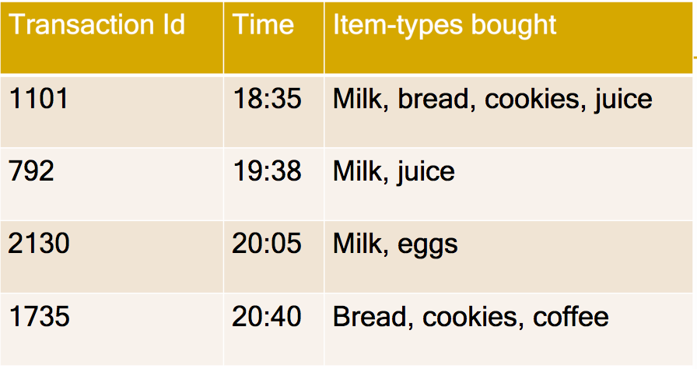
Apriori Algorithm
How to eliminate infrequent item-sets as soon as possible?
Support threshold >= 0.5

Slide 74
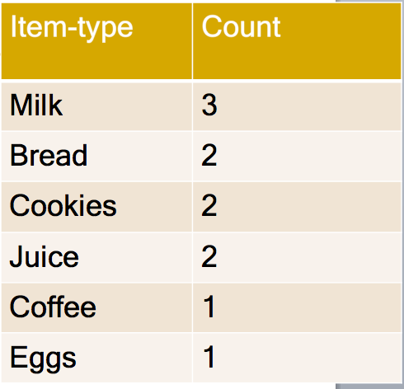
Apriori Algorithm
Eliminate infrequent singleton sets
Support threshold >= 0.5
Milk
Bread
Cookies
Juice
Coffee
Eggs

Slide 75
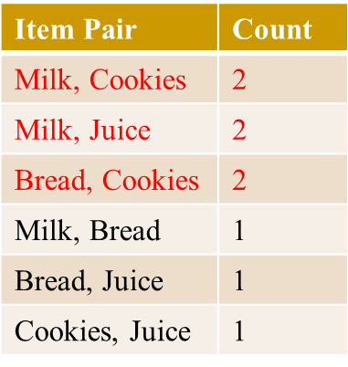
Apriori Algorithm
Make pairs from frequent items & prune infrequent pairs!
Support threshold >= 0.5
MB
MC
MJ
BC
BJ
CJ
Milk
Bread
Cookies
Juice
Coffee
Eggs
81

Slide 76
Apriori Algorithm
Make triples from frequent pairs & Prune infrequent triples!
Support threshold >= 0.5
MBCJ
No triples generated
Due to Monotonicity!
Apriori algorithm
examined only
12 subsets
instead of 64!
MBC
MBJ
MCJ
BCJ
MB
MC
MJ
BC
BJ
CJ
Milk
Bread
Cookies
Juice
Coffee
Eggs

Slide 77
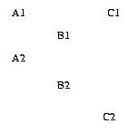
Association Rules Limitations
Transaction is a core concept!
Support is defined using transactions
Apriori algorithm uses transaction based Support for pruning
However, spatial data is embedded in continuous space
Transactionizing continuous space is non-trivial !

Slide 78
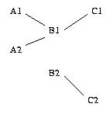
Spatial Association vs. Cross-K Function
Spatial Association Rule (Han 95)
Output = (B,C) with threshold 0.5
Transactions by Reference feature, e.g. C
Transactions: (C1, B1), (C2, B2)
Support (A,B) = Ǿ
Support(B,C)=2 / 2 = 1
Cross-K Function
Cross-K (A, B) = 2/4 = 0.5
Cross-K(B, C) = 2/4 = 0.5
Cross-K(A, C) = 0
Input = Feature A,B, and, C, & instances A1, A2, B1, B2, C1, C2
Output = (A,B), (B, C) with threshold 0.5

Slide 79
Spatial Colocation
Features: A. B. C
Feature Instances: A1, A2, B1, B2, C1, C2
Feature Subsets: (A,B), (A,C), (B,C), (A,B,C)
Participation ratio (pr):
pr(A, (A,B)) = fraction of A instances neighboring feature {B} = 2/2 = 1
pr(B, (A,B)) = ½ = 0.5
Participation index (A,B) = pi(A,B) = min{ pr(A, (A,B)), pr(B, (A,B)) } = min (1, ½ ) = 0.5
pi(B, C) = min{ pr(B, (B,C)), pr(C, (B,C)) } = min (1,1) = 1
Participation Index Properties:
(1) Computational: Non-monotonically decreasing like support measure
(2) Statistical: Upper bound on Ripley’s Cross-K function

Slide 80
Participation Index >= Cross-K Function
B.1
A.1
B.1
A.1
B.1
A.1
A.3
A.3
A.3
B.2
A.2
B.2
A.2
B.2
A.2
Cross-K (A,B) | 2/6 = 0.33 | 3/6 = 0.5 | 6/6 = 1
PI (A,B) | 2/3 = 0.66 | 1 | 1

Slide 81
Association Vs. Colocation
 | Associations | Colocations
underlying space | Discrete market baskets | Continuous geography
event-types | item-types, e.g., Beer | Boolean spatial event-types
collections | Transaction (T) | Neighborhood N(L) of location L
prevalence measure | Support, e.g., Pr.[ Beer in T] | Participation index, a lower bound on Pr.[ A in N(L) | B at L ]
conditional probability measure | Pr.[ Beer in T | Diaper in T ] | Participation Ratio(A, (A,B)) = Pr.[ A in N(L) | B at L ]

Slide 82
Spatial Association Rule vs. Colocation
Spatial Association Rule (Han 95)
Output = (B,C)
Transactions by Reference feature C
Transactions: (C1, B1), (C2, B2)
Support (A,B) = Ǿ, Support(B,C)=2 / 2 = 1
Cross-K Function
Cross-K (A, B) = 2/4 = 0.5
Cross-K(B, C) = 2/4 = 0.5
Input = Spatial feature A,B, C, & their instances
Output = (A,B), (B, C)
Colocation - Neighborhood graph
Output = (A,B), (B, C)
PI(A,B) = min(2/2,1/2) = 0.5
PI(B,C) = min(2/2,2/2) = 1

Slide 83
Spatial Colocation: Trends
Algorithms
Join-based algorithms
One spatial join per candidate colocation
Join-less algorithms
Spatio-temporal
Which events co-occur in space and time?
(bar-closing, minor offenses, drunk-driving citations)
Which types of objects move together?

Slide 84
Quiz
Which is false about concepts underlying association rules?
a) Apriori algorithm is used for pruning infrequent item-sets
b) Support(diaper, beer) cannot exceed support(diaper)
c) Transactions are not natural for spatial data due to continuity of
geographic space
d) Support(diaper) cannot exceed support(diaper, beer)

Slide 85
Outline
Motivation, Spatial Pattern Families
Spatial data types and relationships
Limitations of Traditional Statistics
Location Prediction model
Hotspots
Spatial outliers
Colocations and Co-occurrences
Summary: What is special about mining spatial data?

Slide 86
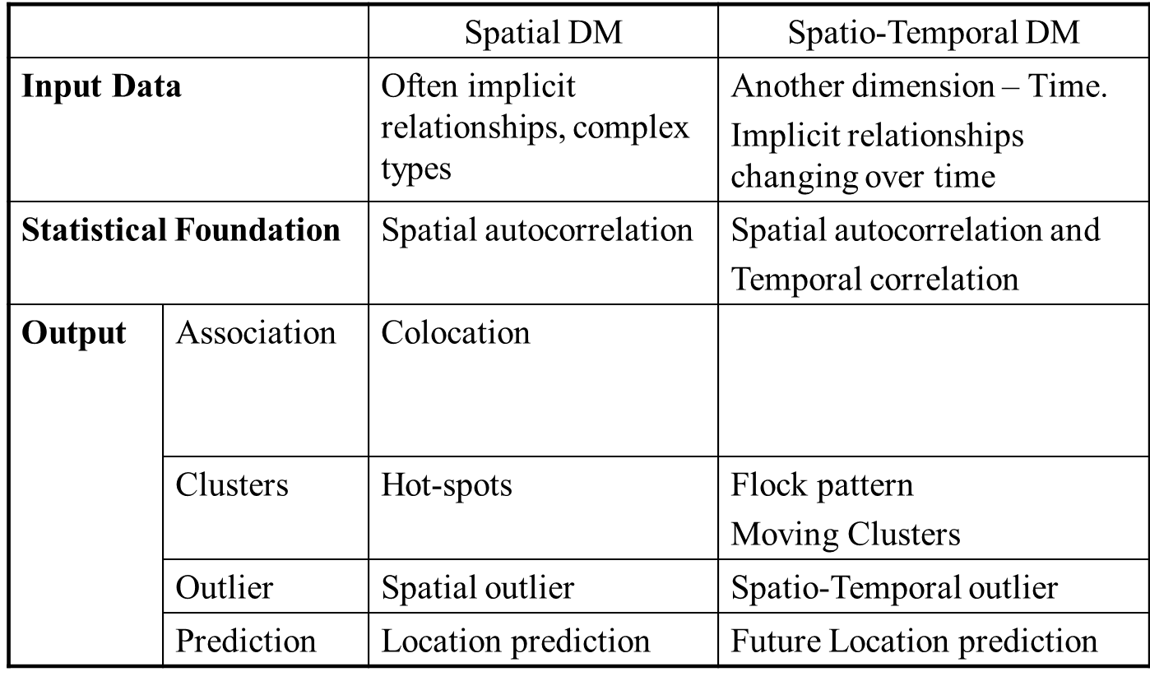
Summary
What’s Special About Mining Spatial Data ?

Slide 87
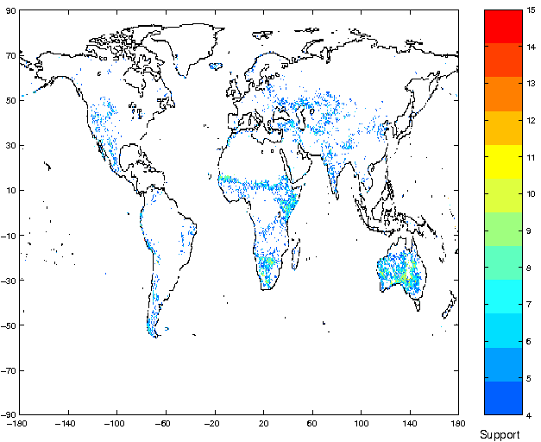
Three General Approaches in SDM
A. Materializing spatial features, use classical DM
Ex. Huff's model – distance (customer, store)
Ex. spatial association rule mining [Koperski, Han, 1995]
Ex: wavelet and Fourier transformations
Commercial tools: e.g., SAS-ESRI bridge
B. Spatial slicing, use classical DM
Ex. Regional models
Commercial tools: e.g., Matlab, SAS, R, Splus
Association rule with support map
(FPAR-high -> NPP-high)

Slide 88
Review Quiz
Consider an Washingtonian.com article about election micro-targeting using a database of 200+ Million records about individuals. The database is compiled from voter lists, memberships (e.g. advocacy group, frequent buyer cards, catalog/magazine subscription, ...) as well polls/surveys of effective messages and preferences. It is at www.washingtonian.com/articles/people/9627.html

Slide 89
Review Quiz – Question 1
Q1. Match the following use-cases in the article to categories of traditional SQL2 query, association, clustering and classification:
(i) How many single Asian men under 35 live in a given
congressional district?
(ii) How many college-educated women with children at home are in
Canton, Ohio?
(iii) Jaguar, Land Rover, and Porsche owners tend to be more
Republican, while Subaru, Hyundai, and Volvo drivers lean
Democratic.
(iv) Some of the strongest predictors of political ideology are things
like education, homeownership, income level, and household size.

Slide 90
Review Quiz – Question 1 (Continued)
Q1. Match the following use-cases in the article to categories of traditional SQL2 query, association, clustering and classification:
(v) Religion and gun ownership are the two most powerful predictors
of partisan ID.
(vi) ... it even studied the roads Republicans drove as they commuted
to work, which allowed the party to put its billboards where they
would do the most good.
(vii) Catalyst and its competitors can build models to predict voter
choices. ... Based on how alike they are, you can assign a
probability to them. ... a likelihood of support on each person
based on how many character traits a person shares with your
known supporters..
(viii) Will 51 percent of the voters buy what RNC candidate is offering?
Or will DNC candidate seem like a better deal?

Slide 91
Review Quiz – Question 2
Q2. Compare and contrast Data Mining with Relational Databases.

Slide 92
Review Quiz – Question 3
Q3. Compare and contrast Data Mining with Traditional Statistics (or Machine Learning).

